Slide 1
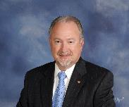


PDG Rich Glover, DRFC District 7620
THE ROTARY FOUNDATION
Part I – 105 Years of TRF History
v. 03/10/2022
This is …

Slide 2



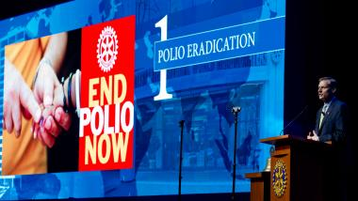
District 7620
TRF Learning Series
Chapter I - The First Century Of TRF History
105 YEARS OF DOING GOOD IN THE WORLD
Notes:
* Welcome to Part I of the TRF Learning Series – We proudly the current humanitarians in stewardship for over a century. And what a 105 years of history. As you know we enter the 1th year since the founding of Rotary International. Today we specifically begin the date TRF began. This is the first of eight upcoming series about one of the most respected Foundations in the world.

Slide 3
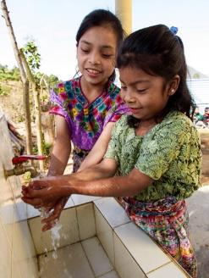
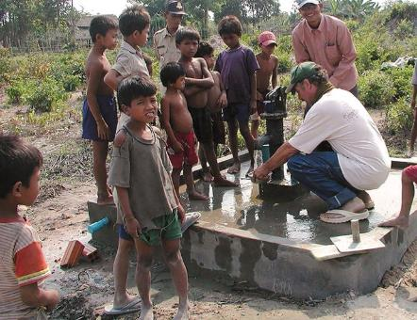
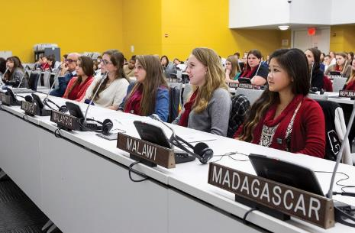

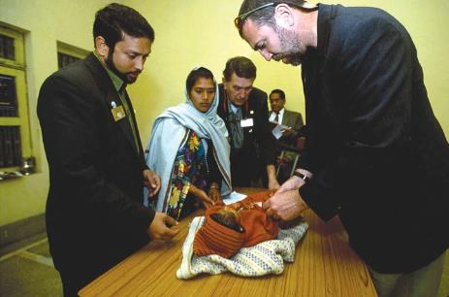
Celebrating a Century of Doing Good in the World
Jean-Mark Giboux
105 YEARS OF DOING GOOD IN THE WORLD
Notes:
Rotarians continue to carry forward the vision, dreams and founding principals of our founders and Rotarians before us, We have now entered the second century of “doing good in the world” creating focused, measured, sustainable and impactful projects within the Four-Way Test of the things we think, say and do. Let’s look at some history.

Slide 4
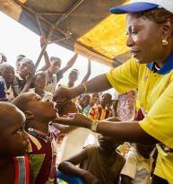
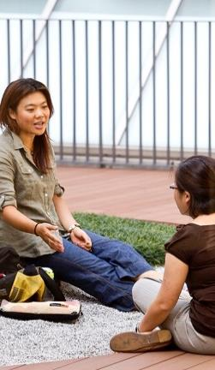
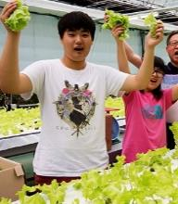
The Rotary Foundation’s Mission
The mission of The Rotary Foundation is to enable Rotarians to advance world understanding, goodwill, and peace through the improvement of health, the support of education, and the alleviation of poverty.
105 YEARS OF DOING GOOD IN THE WORLD
Notes:
Have attendee read the Mission:
Did you know Rotarians are the ENGINE The Rotary Foundation for Rotary’s humanitarian activities, from clubs’ and districts’ local service projects to global initiatives. Rotary also leads the ongoing international effort to eradicate polio worldwide.
Our Foundation is able to achieve its mission through the generous contributions and active participation of Rotarians and friends of Rotary.

Slide 5
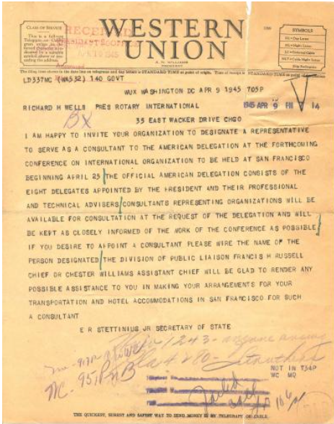

Rotary and the United Nations have a shared history of working toward peace and addressing humanitarian issues around the world.
Telegram inviting Rotary International to serve as a consultant to the U.S. delegation to the San Francisco Conference
Rotary International was one of 42 organizations the United States invited to serve as consultants to its delegation
Notes:
Did you know that Rotary International has a seat at the United Nations. In fact, as you see here is the Western Union Telegram inviting RI to designate an RI Representative from April to June 1945, delegations from 47 nations attended the United Nations Conference. Their task was to write a charter acceptable to all of the nation representatives. The delegations were assisted in this historic effort by a large number of staff, advisers, and consultants.

Slide 6
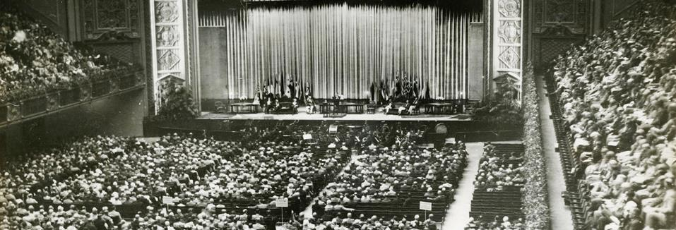
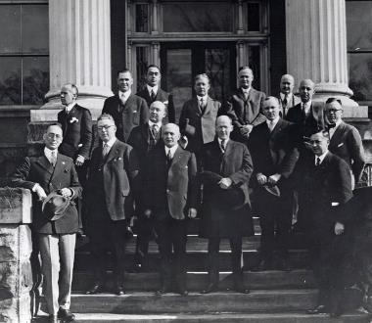
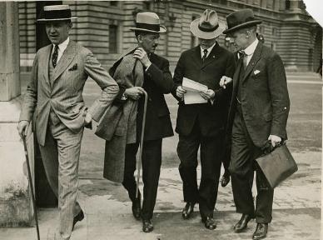
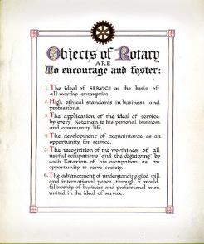
The Early Years
105 YEARS OF DOING GOOD IN THE WORLD
Notes:
Establishing Rotary’s Purpose: In 1911, members of the Rotary Club of Seattle presented The Object of Rotary as a core platform for service and good citizenship as professionals. And an early picture of a Annual Rotary Convention to promote the Objectives of Rotary.

Slide 7
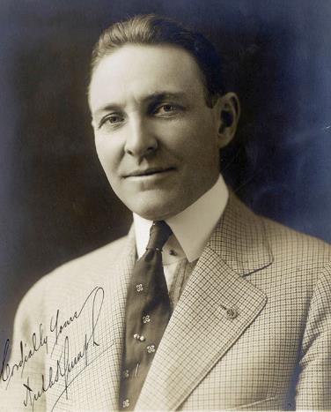
Arch Klumph’s Vision — 1917
It seems eminently proper that we should accept endowments for the purpose of doing good in the world, in charitable, educational or other avenues of community progress …
— Arch Klumph, 1917
105 YEARS OF DOING GOOD IN THE WORLD
Notes:
* One of many historical quotes from Arch Klumph. < READ > This is why he is recognized as the “Father of the Foundation” because he had the vision of a Rotary endowment fund and the dedication to bring this dream to life.
* As President of the Rotary Club of Cleveland, Ohio, USA, in 1913, he advocated for the club to build a reserve that would ensure its means to do future good work.
* As our 6th Rotary International President in 1916-17, he proposed this idea to a larger audience.
In his speech to the 1917 convention in Atlanta, he made this statement to the convention attendees.
* Arch’s vision of an endowment would eventually become The Rotary Foundation, and his call for “doing good in the world” was to become the Foundation’s motto. But it would take some time, however, for all of that to happen.

Slide 8

The “Father of the Rotary Foundation” is because Arch Klumph had the vision of a Rotary endowment fund and the dedication to bring this dream to life.
Although Arch believed strongly in the need for the Foundation, he emphasized that all contributions should be voluntary. He did not want Rotarians to view the Foundation as a tax or assessment on clubs or members, which would have violated the association’s constitution.
Our job is:
- to create a living Legacy of a GIVING & GRANT CULTURE in our clubs
- to inspire the SPIRIT & share the ART OF GIVING
Notes:
He also emphasized: True Rotarians do not brag about their Wealth & Giving … Rather, We brag by TELLING OUR STORIES and the inspiration from our experience in making a difference, making an impact, to those in our communities and around the world through supporting the TRF & Annual Fund.

Slide 9
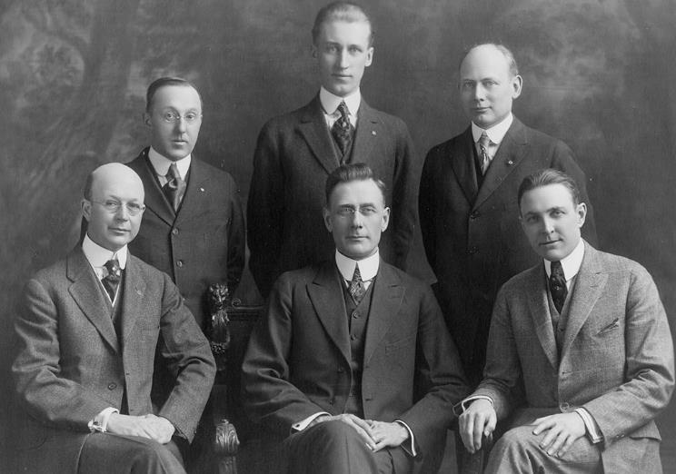
Arch Klumph’s Vision — 1917
Rotary’s 1917-18 Board of Directors
105 YEARS OF DOING GOOD IN THE WORLD
Notes:
* The 1917 convention delegates agreed with Arch’s vision and voted to amend the Rotary constitution to establish an endowment fund.
This fund was “to be made up of contributions from clubs, individuals, estates and other Rotarian sources.”
The fund’s principal was to remain intact, with only the interest used to further Rotary’s goals. The delegates named Rotary’s Board of Directors as trustees of the fund.
Although this fund started the Foundation, it is not the same as today’s Endowment Fund, which was established in the 1980s.

Slide 10

First Contribution — 1917
Notes:
In 1917, the Rotary Club of Kansas City, Missouri, USA, (#13 ) made the first contribution, $26.50, to the endowment fund that Arch Klumph had suggested in his convention speech. But for almost a decade, the endowment went largely unknown and received very few contributions.
In 2017, the International Rotary Convention celebrated the 100th Anniversary of the TRF. Those who attended the Atlanta convention may recall the figure of $26.50. Representing the first donation in 1917 was featured in a number of fees and incentives for the convention and a challenge to each Rotarians to contribute $26.50 to TRF to honor our first century of service. And actually there were significant dollars raised from Rotarians to celebrate $26.50.

Slide 11
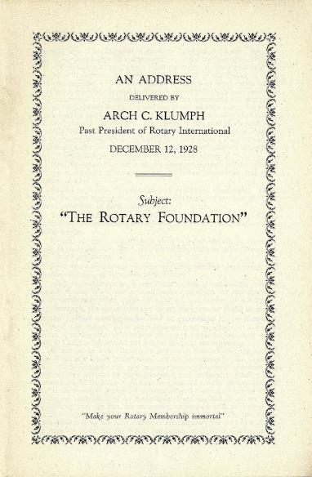
The Rotary Foundation and Trustees — 1928
We are determined that the Endowment Fund shall not be unpopular. … We truly believe that when each and every individual Rotarian understands this matter thoroughly and correctly, there will be few, if any, who do not participate, even though the sum may be extremely modest in amount.
— Arch Klumph, 1928
105 YEARS OF DOING GOOD IN THE WORLD
Notes:
* Have attendee read Klumph’s quote.
* In 1927, Rotary leaders began to show greater interest in the endowment, and the following year, convention delegates formally changed its name to The Rotary Foundation. They also agreed to enlarge its scope and establish a five-member Board of Trustees.
* The Rotary President appointed the first trustees and named Arch Klumph the trustee chair. He served as chair for seven years, educating Rotarians about the Foundation and encouraging them to contribute.
* As mentioned in a previous slide Arch repeated “Although Arch believed strongly in the need for the Foundation, and again he emphasized that all contributions should be voluntary. He did not want Rotarians to view the Foundation as a tax or assessment on clubs or members, which would have violated the association’s constitution.
* Today, the Foundation has 15 trustees who manage the Foundation’s business. They are nominated by the RI president-elect and elected by the RI Board to serve four-year terms. The trustees elect a chair each year.

Slide 12
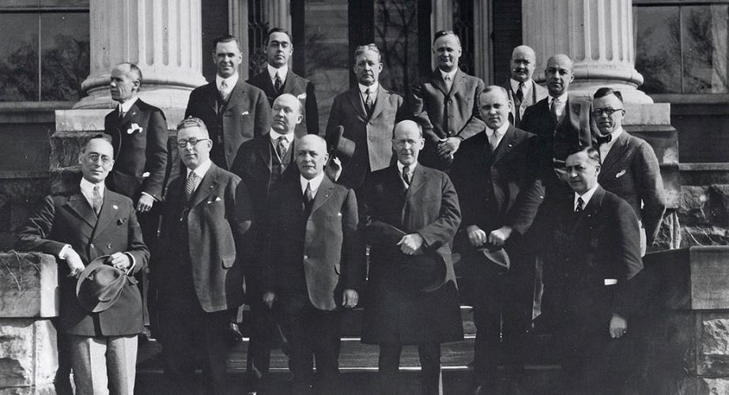
First Grant — 1930
Notes:
* In 1930, the Foundation made its first grant, $500 to the International Society for Crippled Children, now known as Easter Seals.
* Rotarian Edgar “Daddy” Allen had founded Easter Seals in 1919. Rotary founder Paul Harris served on the society’s board of directors.
* In this 1922 photo of the society’s founding members, Allen is in the front row, third from the left, and Paul Harris is standing next to him, fourth from the left.

Slide 13
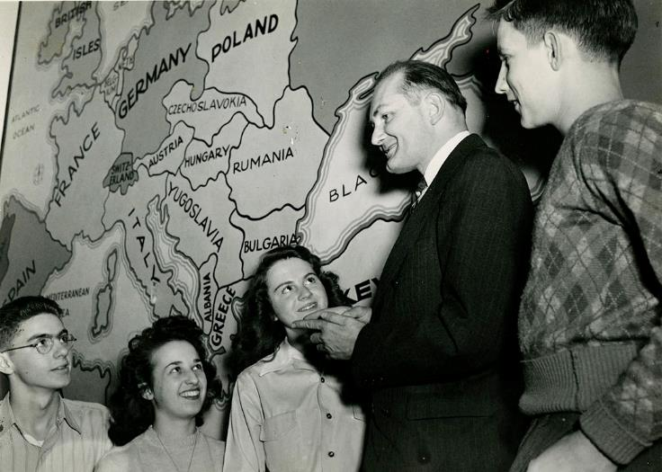
Early Foundation Activities — 1930s
105 YEARS OF DOING GOOD IN THE WORLD
Notes:
* During its early years, the Foundation explored ways to promote what was then known as the sixth object of Rotary: advancement of understanding, goodwill, and international peace.
* In the early 1930s, the Foundation sponsored essay contests for secondary school students on peace-related topics and recognized the winners at the 1931 and 1933 conventions.
* Institutes of International Understanding were another early initiative. The Foundation encouraged clubs to organize programs and invite prominent guest speakers to discuss critical world issues. The Foundation helped pay speakers’ expenses if the club could not afford them.
* The high school students shown here were attending an Institute for International Understanding in Sturgis, Michigan, USA.

Slide 14
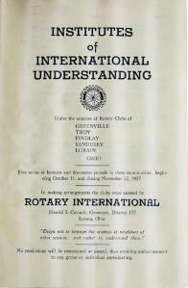
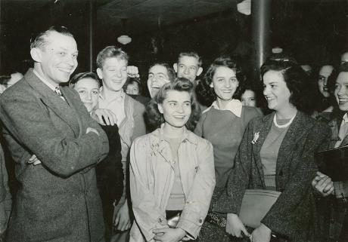
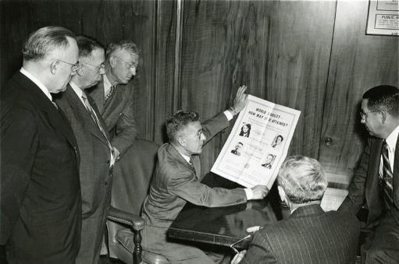
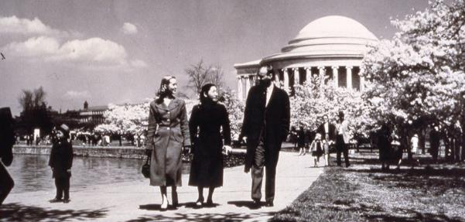
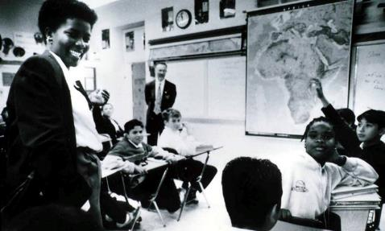
Programs
105 YEARS OF DOING GOOD IN THE WORLD
Notes:
These are early photos of the evolving Rotary programs in clubs, serving communities, domestically and around the world.

Slide 15
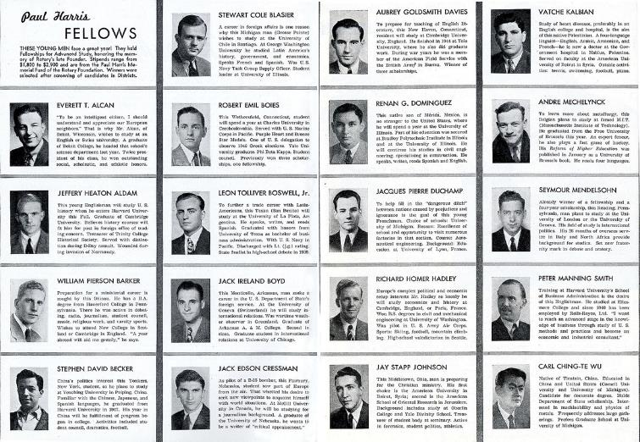
First Program: Scholarships for Graduate Study — 1947
105 YEARS OF DOING GOOD IN THE WORLD
Notes:
In 1947, the Foundation launched its first program: scholarships for graduate study. The first group of scholars, spotlighted here in The Rotarian magazine, began their studies in the 1947-48 academic year.
The program’s criteria have changed a few times during its seven decades, and so has its name — the students have been called Paul Harris Fellows, Ambassadorial Scholars, and Rotary Scholars. But the concept of sending promising students abroad for graduate study remains the same.
Notable Rotary Scholars have included Helmut Jahn, architect; Keith Rayner, former Anglican archbishop and primate of Australia; Naoko Yamazaki, astronaut; Sadako Ogata, Japanese diplomat and UN High Commissioner for Refugees; and Roger Ebert, Pulitzer Prize-winning film critic.
EXTRA: Watch a video of Roger Ebert talking about his year as a Rotary Scholar at https://vimeo.com/63594762

Slide 16
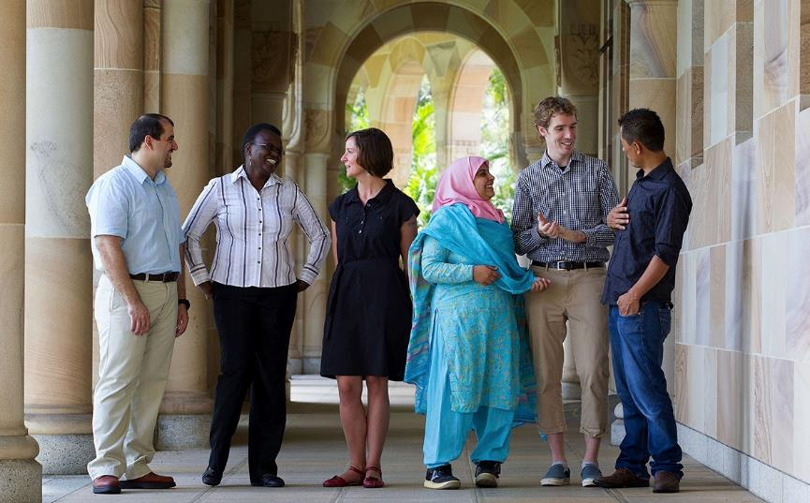
Today’s Scholars
105 YEARS OF DOING GOOD IN THE WORLD
Notes:
Today, Rotary Scholars pursuing graduate degrees receive Foundation support through global grants and district grants, and Rotary Peace Fellows study at now 7 Rotary Peace Centers.
Since the program began in 2002, the Rotary Peace Centers have trained more than 1,300 fellows who now work in more than 115 countries. Many serve as leaders in governments, NGOs, the military, education, law enforcement, and international organizations like the United Nations and the World Bank.
Like participants of past scholarship programs, today’s Rotary Scholars and peace fellows gain knowledge and skills that help them to further the Foundation’s humanitarian and peace-building missions.
* Each year, up to 100 Rotary Peace Fellows are chosen to participate in a master’s degree or certificate program at one of our six centers around the world.

Slide 17
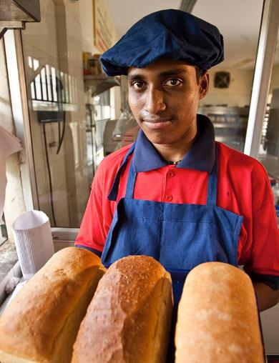
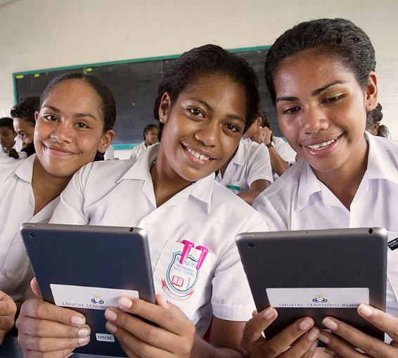
Matching Grants
105 YEARS OF DOING GOOD IN THE WORLD
Notes:
* In 1963-64, RI President Carl Miller focused on reducing the tensions of the Cold War by bringing people of different cultures and beliefs together. In 1964, the Trustees approved the Special Grants program, later called Matching Grants, which provided funding for clubs and districts to undertake projects that furthered international understanding. Members in two countries often worked together on humanitarian projects, and eventually this became a program requirement.
* Over the course of the program, the Foundation awarded more than 37,000 Matching Grants worth well over $500 million in more than 200 countries. The projects addressed a wide range of needs, providing everything from technical training to literacy programs to clean water.

Slide 18
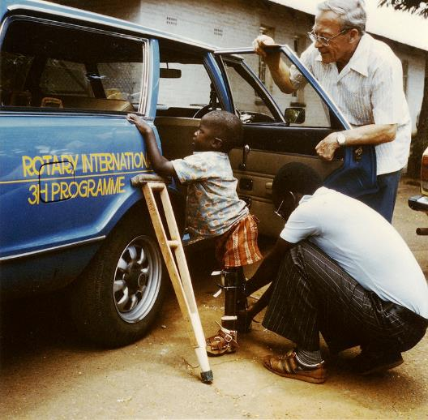
Health, Hunger, and Humanity (3-H) Grants — 1978
105 YEARS OF DOING GOOD IN THE WORLD
Notes:
* In the late 1970s, Rotary leaders began looking for a way to inspire large international projects to mark Rotary International’s 75th anniversary in 1980. In 1978, the Foundation created the Health, Hunger, and Humanity (3-H) program. In
* Throughout the three decades that followed, the 3-H program supported a wide range of other health-related projects, from eye camps to prosthetic limbs to mobile clinics in remote areas.

Slide 19
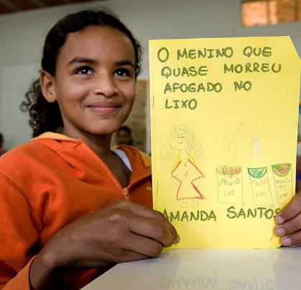
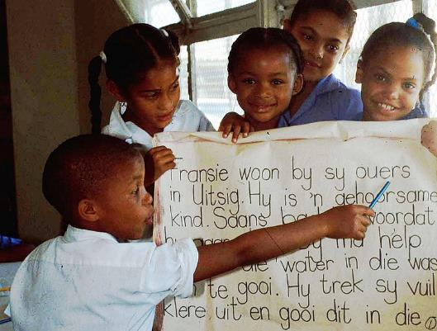
Health, Hunger, and Humanity (3-H)
105 YEARS OF DOING GOOD IN THE WORLD
Notes:
Literacy was another major focus of 3-H grants. Australian Rotarian Richard Walker developed a literacy training method called Concentrated Language Encounter (CLE) and used a grant to start a literacy program in Thailand. The program proved so successful that it was replicated in Brazil (shown here at left) and South Africa (shown at right), among other countries.

Slide 20
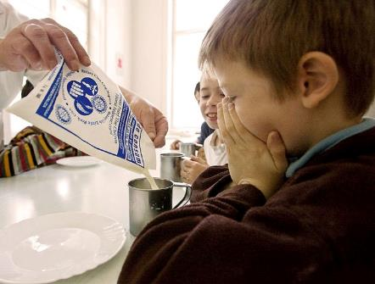
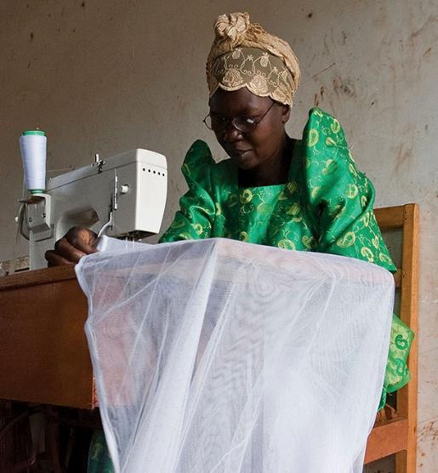
Health, Hunger, and Humanity (3-H)
105 YEARS OF DOING GOOD IN THE WORLD
Notes:
In addition to fighting disease and supporting education, 3-H grants:
Supplied food and milk to orphanages and hospitals in Romania
Provided sewing machines and training to women in Uganda, so that they could support themselves and their families
Built wells and sanitation systems in India, Bolivia, and many other parts of the world

Slide 21
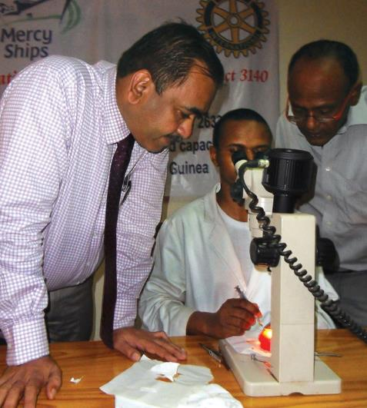
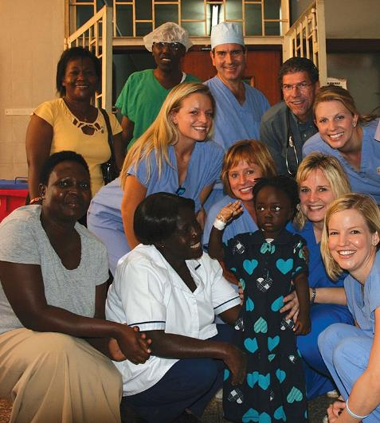
District Grants
Arun Chaudhadi
Salim Najar
105 YEARS OF DOING GOOD IN THE WORLD
Notes:
* District grants fund small-scale, short-term activities that address needs in local communities and communities abroad. Each district chooses which activities it will fund with these grants. Some districts choose to allocate smaller grants to support several club projects.
District grants can fund many kinds of district and club efforts, including:
* Humanitarian projects, including service travel and disaster recovery efforts
* Scholarships for any level, length of time, location, or area of study
* Vocational training teams

Slide 22
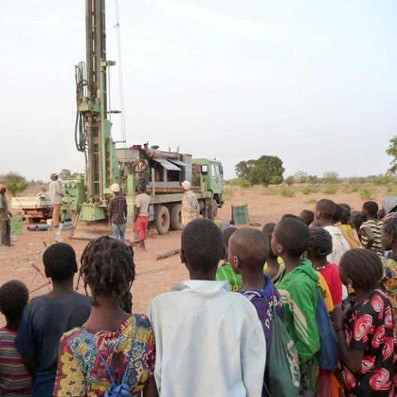
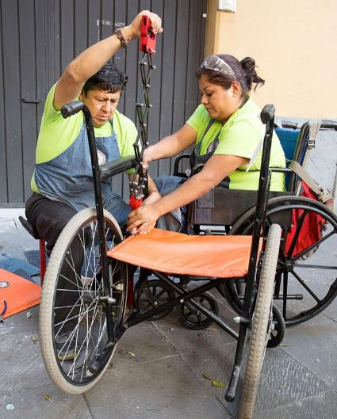
global Grants
105 YEARS OF DOING GOOD IN THE WORLD
Notes:
Global grants support large-scale international activities with sustainable, measurable outcomes in one or more of Rotary’s seven areas of focus. Grant sponsors form international partnerships and work together to develop projects that respond to real community needs.
Global grants can fund:
Humanitarian projects
Scholarships for graduate-level academic studies
Vocational training teams
For example, the global grant project shown on the right supports a mobile repair shop that travels to cities in Mexico. Disabled workers employed by a project partner design, fabricate, and repair specialty wheelchairs and custom wheeled devices. Rotary clubs in each city coordinate permits, access to electricity, housing for workers, and marketing.
Another global grant in Burkina Faso, shown on the left, installed a well in an area where droughts are frequent and women and children had to walk several kilometers a day to get water. Many local residents watched the drilling continue through the night, excited by the promise of having clean drinking water.

Slide 23
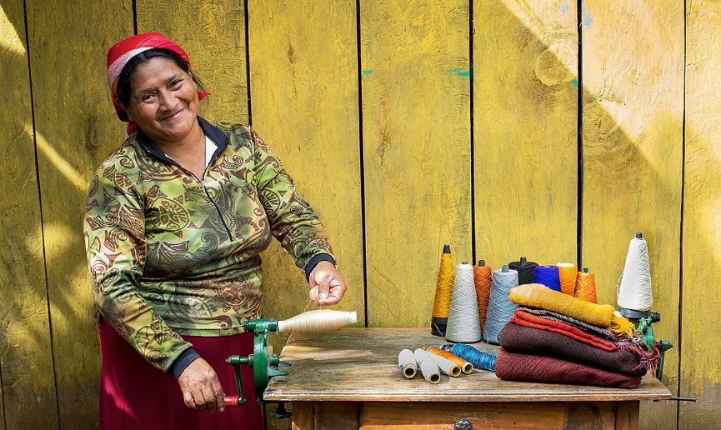
Global Grants
105 YEARS OF DOING GOOD IN THE WORLD
Notes:
A global grant such as the microcredit lending project sponsored by a Rotary club in Honduras and clubs from District 5340 in California, USA, helps poor women in Honduras become self-sufficient business owners.

Slide 24

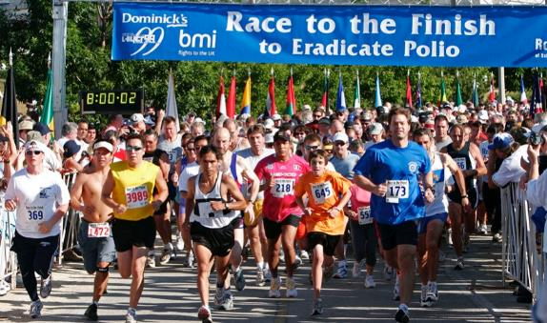
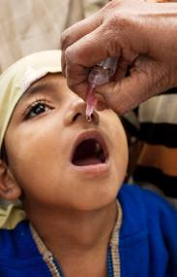
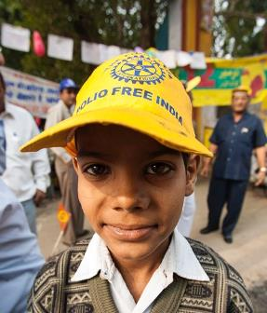
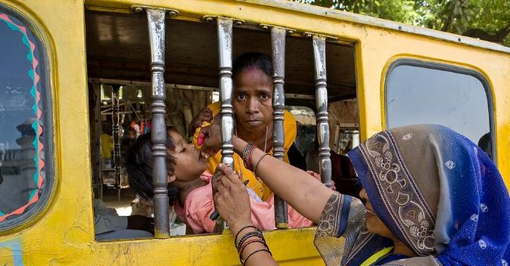
PolioPlus
103 YEARS OF DOING GOOD IN THE WORLD
Notes:
* Did you know, one of our own in D-7620, PDG Dr. John Sever 1978-1979, (RC Potomac), Chief of the Infectious Disease Branch, Institute of Neurological Disease, NIH, District Governor of Rotary District 7620 and our then Rotary International President Sir Clem Renouf - Australia are recognized as the “Founding Father’s” and instrumental in the Rotary International Polio Eradication program in the late 1970’s.
In 1979, Rotary International’s effort to eradicate polio began its first grant gave $760,000 to a multiyear project to immunize 6 million children in the Philippines against polio.
In 2018, PDG Ken Solow 2015-2016 was the Producer of the Polio Documentary “Dare to Dream”. View this film https://daretodreamfilm.com/

Slide 25
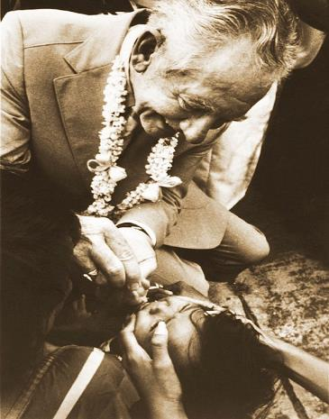
The First 3-H Polio Grant — 1979
105 YEARS OF DOING GOOD IN THE WORLD
Notes:
1979-80 RI President James Bomar signed an agreement with the Philippine government and kicked off the project by administering oral polio vaccine to children in Manila.
Rotary leaders announced these ambitious plans in early 1985, and later that year, they introduced the program’s new name: PolioPlus. The “Plus” initially referred to the additional vaccines that were administered along with polio vaccine. Today, it also reflects the idea that the infrastructure, fundraising, and advocacy methods implemented by the polio eradication effort will support future battles against infectious disease.
In a 1993 interview, Bomar recalled how the brother of one child he had immunized tugged on his pant leg to get his attention. When he looked down, the boy said to him, "Thank you, thank you, Rotary."

Slide 26
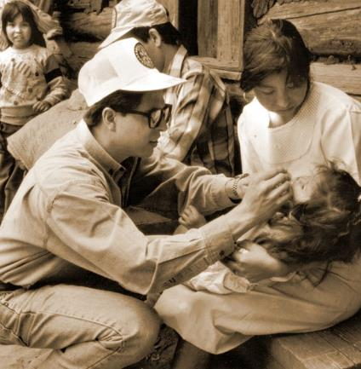
PolioPlus — 1985
1980
Rotary’s Council on Legislation endorses a proposal to “eliminate polio through immunization”
Immunization efforts continue as part of the 3-H program
1985
PolioPlus is launched
105 YEARS OF DOING GOOD IN THE WORLD
Notes:
The project in the Philippines was just the beginning.
The 1980 Council on Legislation endorsed a proposal from the RI Board to “eliminate polio through immunization.” This allowed Rotary to promote immunization without violating a 1923 decision that prohibited “corporate projects.”
In 1984, the RI Board made a series of decisions that resulted in what we now know as the PolioPlus program and established a fund to support it. Initially, the program was called Polio 2005, in reference to a goal of immunizing all the world’s children by 2005.
Rotary leaders announced these ambitious plans in early 1985, and later that year, they introduced the program’s new name: PolioPlus. The “Plus” initially referred to the additional vaccines that were administered along with polio vaccine. Today, it also reflects the idea that the infrastructure, fundraising, and advocacy methods implemented by the polio eradication effort will support future battles against infectious disease.

Slide 27
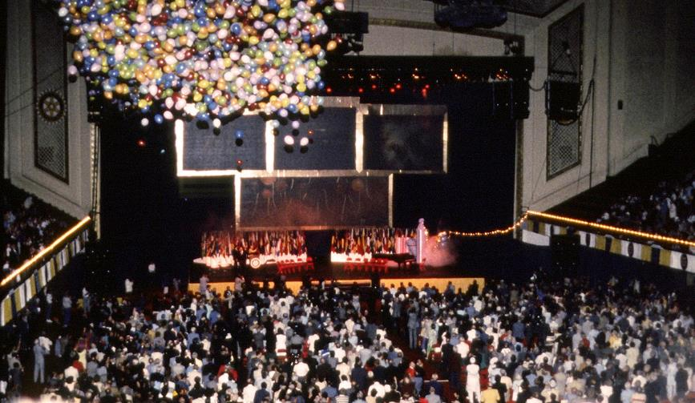
PolioPlus Campaign — 1980s
105 YEARS OF DOING GOOD IN THE WORLD
Notes:
Rotary began a three-year fundraising campaign with a goal of raising $120 million. The campaign focused on educating club members about the need to eradicate polio and the many benefits of a polio-free world. Rotary leaders met with other nongovernmental organizations and government officials to convince them of the feasibility of their goal and gain their support.
The campaign raised $247 million, more than double the goal. The effort was the first of its kind in Rotary’s history, and the occasion was celebrated at the 1988 Rotary convention in Philadelphia, Pennsylvania, USA.

Slide 28
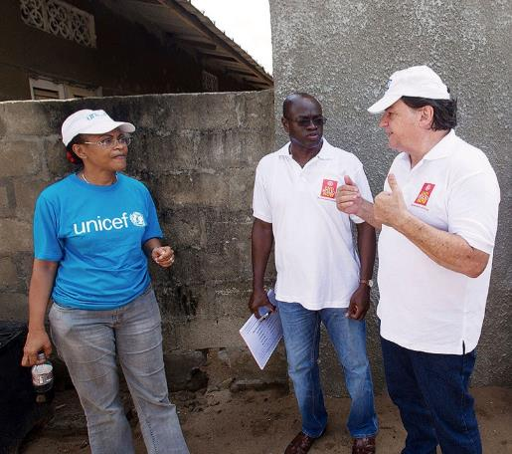
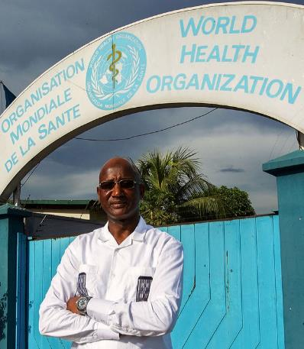
Global Polio Eradication Initiative — 1988
105 YEARS OF DOING GOOD IN THE WORLD
Notes:
Rotary’s early efforts set the stage for the formation of the Global Polio Eradication Initiative (GPEI) in 1988. ** True story” Originally we approached WHO…. Finally, t The GPEI’s original members were Rotary, the World Health Organization (WHO), the U.S. Centers for Disease Control and Prevention (CDC), and UNICEF.
At that time, 350,000 children were afflicted by polio every year. Today, that number has been reduced by 99.9 percent, and polio is endemic in only two countries — Afghanistan and Pakistan.
Over the years, others have joined the effort, including the Bill & Melinda Gates Foundation and governments throughout the world. Rotary continued its fundraising efforts and as of 2015 had contributed more than $1.5 billion to the eradication effort. In addition, Rotary’s advocacy has resulted in contributions of over $9 billion from world governments.

Slide 29
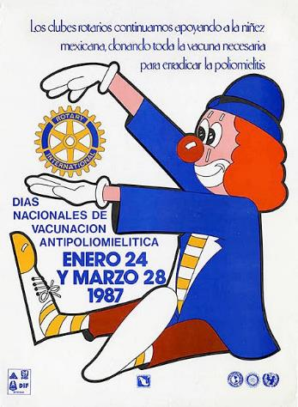
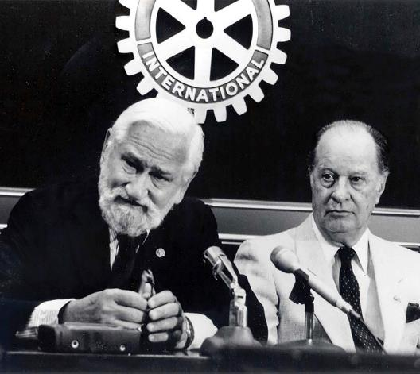
National Immunization Days
105 YEARS OF DOING GOOD IN THE WORLD
Notes:
* The polio eradication initiative owes much of its success to its adoption of mass immunizations, which were advocated by Dr. Albert Sabin (shown at left in the photo), who developed the oral polio vaccine, and Rotary leaders and physicians Carlos Canseco (shown at right in the photo) and D-7620 PDG Dr. John Sever – 1978-1979.
* For a typical National Immunization Day, or NID, thousands of immunization posts are set up throughout a country. Health workers and volunteers immunize millions of children in one day. In what’s known as social mobilization, both during the NID and before, volunteers hang posters, distribute handbills, and even ride through the streets with bullhorns to urge parents to bring all children younger than five to be vaccinated.
Those who receive the oral polio vaccine have their fingers marked with indelible ink. Over the following few days, health workers go from home to home, administering vaccine to eligible children with unmarked fingers. The process is repeated once a few months later, and then again, with the goal of reaching every child under age five every time.

Slide 30
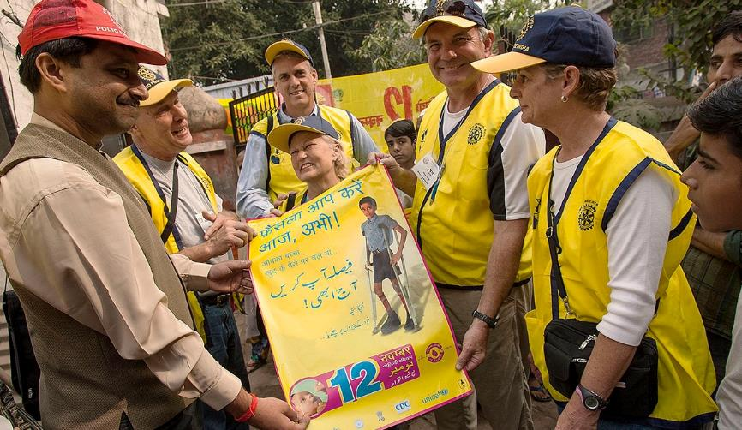
POLIOPLUS PARTNERS – 1995
105 YEARS OF DOING GOOD IN THE WORLD
Notes:
* The social mobilization that precedes an NID is critical to the success of mass immunizations. In 1995, the Foundation launched the PolioPlus Partners program to support social mobilization for National Immunization Days.
* Through PolioPlus Partners, a network of regional and national PolioPlus committees determine what supplies are needed, such as vaccine carriers, banners, brochures, and PolioPlus T-shirts, aprons, and caps to identify members of vaccination teams. The national committee chairs distribute the list, and the program provides funding.
* When India prepared for its first National Immunization Days in 1995, it identified a need for hundreds of aprons for volunteers. Japanese Rotarians contributed enough funds to buy not only aprons but also caps, posters, banners, and vaccine carriers. Indian Rotarians mobilized about 100,000 volunteers to publicize the upcoming immunizations and administer the vaccine.

Slide 31






Contributions and Recognition
103 YEARS OF DOING GOOD IN THE WORLD
Notes:
TRF is always following through with those contributors with cognition.

Slide 32


Contribution History
“Paul Harris had expressed hope that instead of funeral flowers money might be sent to [the] Foundation
for furthering international understanding.”
105 YEARS OF DOING GOOD IN THE WORLD
Notes:
It began in 1947, when Paul Harris died after a prolonged illness. Rotary’s beloved founder had told friends that if they wanted to honor him, they should donate to the Foundation. So Rotary established a special fund for the contributions that flooded headquarters as news of Paul’s death spread.
In just 18 months, the Foundation received $1.3 million. Contributions continued to increase over the years, and they first topped $1 million in a single year in 1965.
At the 1978 convention in Tokyo, Rotary announced a two-year 75th anniversary fund, which would receive more than $7.2 million.
In 2004, the Foundation started the Every Rotarian, Every Year campaign to stimulate giving to the Annual Fund, which supports Foundation grants. In 2014-15, that fund received a record $123 million in contributions.

Slide 33





The Foundation’s Impact
Jean-Mark Giboux
105
YEARS OF DOING GOOD IN THE WORLD
Notes:
So the Foundations impact has dramatically grown around the world.

Slide 34

What Historical Moment
Occurred in 1987 Making Rotary History ?

Slide 35
Rotary History
Women in Rotary
  In 1987, Dr. Silvia Whitlock became president of the Rotary Club of Duarte making her the first woman to hold such a position within Rotary International.
  The chapter's charter had previously been revoked in 1978 after they violated Rotary International policy by admitting women in to their club.
  The Duarte club filed suit in the California courts claiming that Rotary Clubs are business establishments subject to regulation under California's Unruh Civil Rights Act, a law that bans discrimination based on race, gender, religion or ethnic origin.
  Rotary International appealed the decision to the U.S. Supreme Court.
  On May 4, 1987, the United States Supreme Court confirmed the Californian decision supporting women, in the case Board of Directors, Rotary International v. Rotary Club of Duarte. After the ruling, Rotary International ended their policy of gender restrictions.
https://en.wikipedia.org/wiki/Sylvia_Whitlock
Notes:
Have attendee read this>

Slide 36

What can your legacy support?
SHARE
World Fund
Area of Focus
Rotary Peace Centers
105 YEARS OF DOING GOOD IN THE WORLD

Slide 37

Did you know… this is …
Do you realize that Rotarians ALONE are the source of funds to the Annual Fund that come back to the district to support our Community and Global grants.
Chronicle of Philanthropy (11/21) rates us #66 of the worlds Top 100 largest Public Charities by Annual Donations
Only 1% of the charities evaluate by Charity Navigator have received at least ten consecutive four-star evaluations.
Our efficiency is recognized 14 years consecutively by Charity Navigator.
105 YEARS OF DOING GOOD IN THE WORLD

Slide 38

Follow the money – from Annual Fund to DDF-Share Grant monies
Community
Rotarian Contributions To Annual Fund ONLY
3 years
Global
105 YEARS OF DOING GOOD IN THE WORLD

Slide 39
Worldwide Events
WW Members with Annual Fund Giving
Depression
WWII
Hong Kong flu 1M perished
Energy crisis & recession
Black Monday & recession
Asian financial crisis & dotcom bubble
2008 recession & EU debt crisis
Membership
Giving (USD)
105 YEARS OF DOING GOOD IN THE WORLD
Notes:
The Foundation’s assets grew slowly over its first 30 years. In 1947, our Founder Paul Harris died. A surge in contributions began to recognize our founder Paul Harris. By the end of the 1947-48 Rotary year, it had received only about $2 million in contributions since 1917.
* Today, the Foundation’s assets stand at more than $1.4 Billion. What led to such a remarkable increase in donations?
Worldwide events had impact on Membership and Giving. See graph…
Membership and Giving amounts over the years shown alongside economic & health events and slope of giving is interesting to me.
Even more important to support the Annual Fund every year to keep up with the needs of our communities and the world.

Slide 40


THE ROTARY ENDOWENT OBJECTIVES AND GROWTH
105 YEARS OF DOING GOOD IN THE WORLD
Notes:
This graphic shows the growth & assets of the Rotary TRF. I’d like to give you clarity on what are big numbers. Dark view … Light Blue view… We have an outsourced portfolio management company to invests assets to ensure funding for today’s programs, while, sufficiently grow the portfolio to support programs in the future. TRF seeks to generate an average annual investment return over time at least equal to the rate of inflation.

Slide 41

District’s strong financial position leads to creation of an endowment fund to benefit district clubs
Gift ID: E12224
On January 22, 2021, The Rotary Foundation Chief Philanthropy Officer approved the establishment of the
“District 7620 Central MD & DC Endowment Fund”

Slide 42





We should not live for ourselves alone, but for the joy in doing good for others
— Arch Klumph, 1929
Notes:
Through the Rotary Foundation, Rotary members find satisfaction in serving others. The Foundation offers countless opportunities for all members, alumni, and their friends to do good in their communities and in the world — and to make a real, life-changing difference for people in need.
And because of the Foundation, people around the world recognize Rotary as an agent of positive change in the world.
There are many ways that you can improve lives today and build a better future though the Rotary Foundation:
Work with an international partner club to develop a project in one of Rotary’s seven areas of focus and apply for a global grant.
Participate in or support your club or district’s grant projects.
Contribute to the Foundation to ensure it can continue to do good in the world for many years to come with gifts through the Annual Fund and Legacy Funds.
I hope you enjoyed this presentation of our innovation and growth in Rotary; this is a small taste of the amazing growth and impact Rotarians has made in our communities and around the world, We have the respect of the world now, and entering our second century.

Slide 43

MORE History
District 7620 Central MD & DC Endowment Fund:
Leaving a Legacy – Serving humanity forever
QUESTIONS?
PDG Rich Glover,
District Rotary Foundation Chair
Cell: (301) 980-4976
Email: 18.19.dg7620@glovercrew.net

Slide 44
WHY IS THE ROTARY FOUNDATION SUCH A BIG DEAL in the world?
We are efficient with our money – with over 90% going to programs.
With < 1 million charities in the US, TRF #1 of the listed charities on GuideStar
Only 1% of the 9000 charities evaluate by Charity Navigator received at least ten consecutive four-star evaluations.
Our efficiency is recognized 14 years consecutively by Charity Navigator.
Charity Navigator rates over 9000 charities – approximately 60 receive 4 stars.
Chronicle of Philanthropy (11/21) rates us #66 of the worlds Top 100 largest Public Charities by Annual Donations
Recently named “World’s Outstanding Foundation” by the Association of Fundraising Professionals (2020).

